Slide 1
a
i
u
e
o
Vowel Sort
u
e
a
i
o

Slide 2
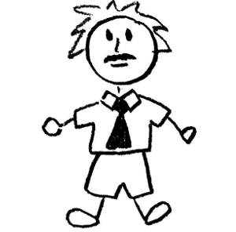
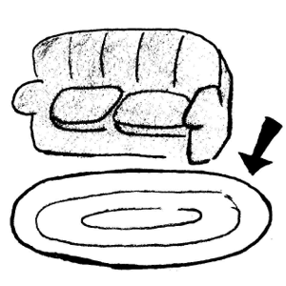
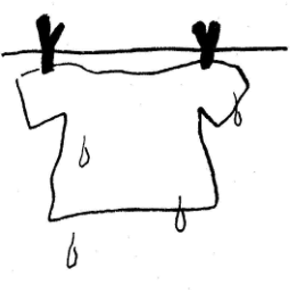
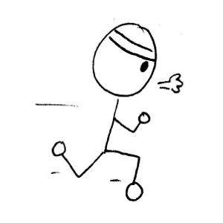
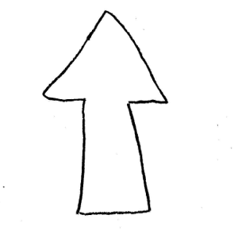
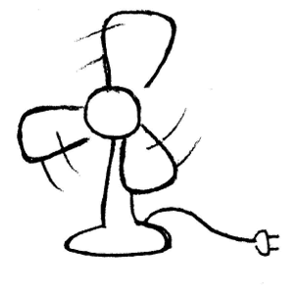
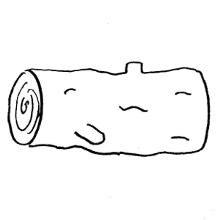
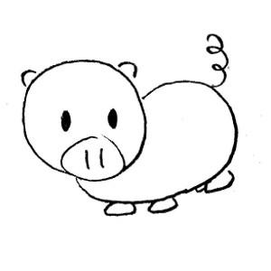
Drag the pictures into the short vowel column in which they belong. Check your work by sliding down the checks at the bottom of the column.
Page
Instructions
Short Vowel Sort
a
e
i
o
u
fan
cat
man
wet
ten
jet
mix
pig
ink
log
box
dog
log
box
dog

Slide 3
Write the word for each short vowel picture or drag the letters from below to spell the word. Drag the check mark to the left to check your answer.
Hint: If you have difficulty selecting an item on the the white of page, click the red background above the box and then try again.
Page
Instructions
jet
rug
cat
ink
log
mix

Slide 4
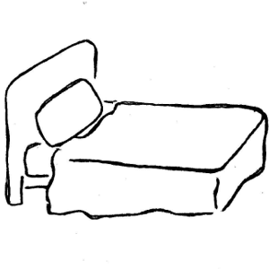
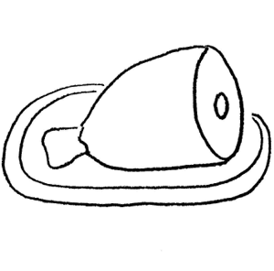
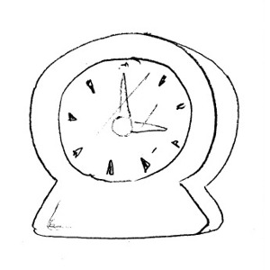
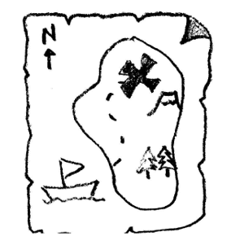
bed
ham
clock
map
egg
cup

Slide 5
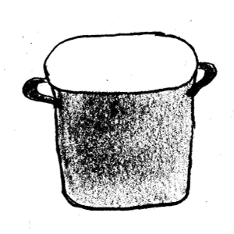
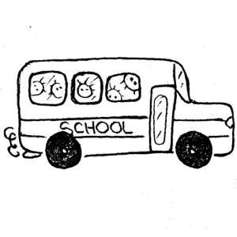
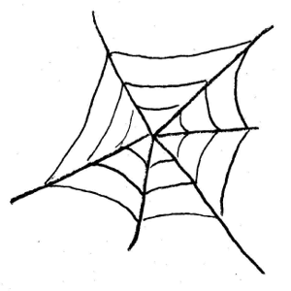
pot
nut
fish
bus
man
web

Slide 6
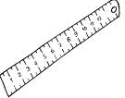
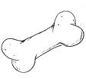
Drag the pictures into the long vowel column in which they belong. Check your work by sliding down the checks at the bottom of the column.
Page
Instructions
Long Vowel Sort
a
e
i
o
u
cake
grape
whale
bee
key
leaf
bike
pie
kite
boat
nose
bone
flute
ruler
fruit

Slide 7
Write the word for each long vowel picture or drag the letters from below to spell the word. Drag the check mark to the left to check your answer.
Hint: If you have difficulty selecting an item on the the white of page, click the red background above the box and then try again.
Page
Instructions
kite
whale
cake
bee
leaf
bike

Slide 8
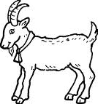
flute
rake
dice
goat
ruler
snake

Slide 9
pot
nut
fish
bus
man
web

