Slide 1
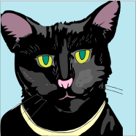
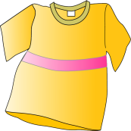
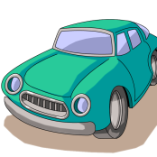
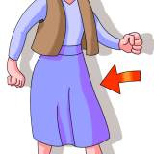
Rhyming Words
cat
cop
fox
shirt
dog
car
top
skirt
fog
box
bat
jar

Slide 2
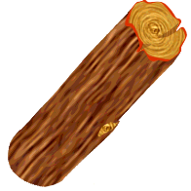
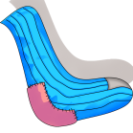
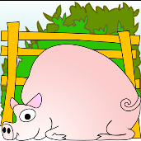
Rhyming Words
mat
log
house
rock
lake
bricks
sticks
rat
mouse
sock
hog
cake

Slide 3
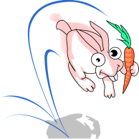
Rhyming Words
bug
frog
mop
sun
tire
eye
tie
dog
run
tug
hop
fire

Slide 4
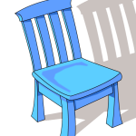
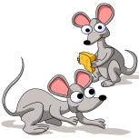
Rhyming Words
cat
shoe
fish
bear
ice
cop
mat
dish
mop
mice
blue
chair

Slide 5
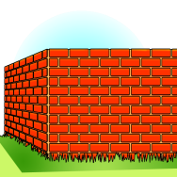
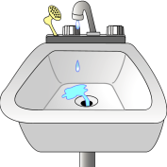
Rhyming Words
block
pink
ball
bed
jog
snake
clock
frog
wall
sink
rake
red

Slide 6
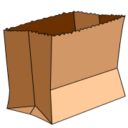
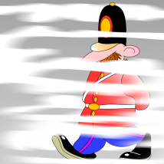
Rhyming Words
tail
log
cat
fan
block
bag
nail
fog
lock
pan
rat
tag

Slide 7
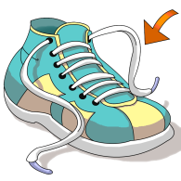
Rhyming Words
cot
dog
clock
face
mat
tan
pot
hat
lock
log
lace
man

Slide 8
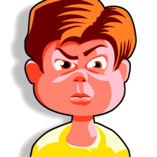
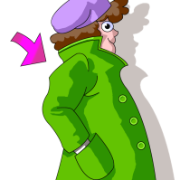
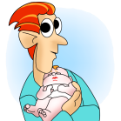
Rhyming Words
hat
mad
hall
tan
boat
tire
rat
wall
coat
pan
man
fire

Slide 9
Rhyming Words
bat
hall
ball
hop
man
sag
hat
hall
fan
bag
cop
call

Slide 10
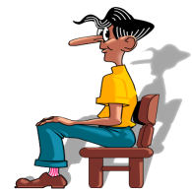
Rhyming Words
tan
truck
call
fox
sad
sat
fan
wall
mad
bat
duck
box

Slide 11
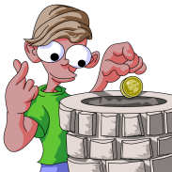
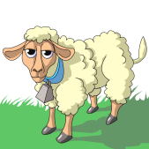
Rhyming Words
mail
fig
kitten
well
sheep
wire
jeep
bell
mitten
fire
tail
wig

Slide 12
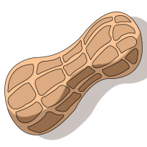
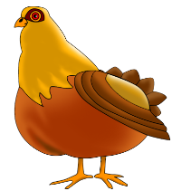
Rhyming Words
cone
fig
nut
rope
hen
tower
10
bone
ten
hut
flower
soap
hog

Slide 13
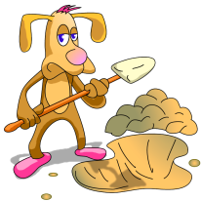
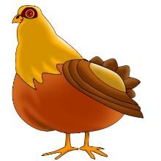
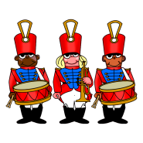
Rhyming Words
pen
sand
dig
puck
drum
mall
band
fig
hen
duck
gum
call

Slide 14
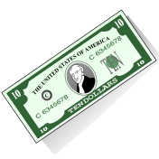
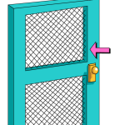
Rhyming Words
mall
three
kick
hive
money
four
ball
sick
bee
five
bunny
door

Slide 15
Rhyming Words

